Slide 1

Anomaly detection in vessel traffic
A SAAB production

Slide 2
Contents
Data exploration
Data visualization
Clustering
Recurrent Neural Network v2
Dynamic Markov Model

Slide 3
Data exploration
Codebook
Correlation matrix
Missing data / odd data

Slide 4
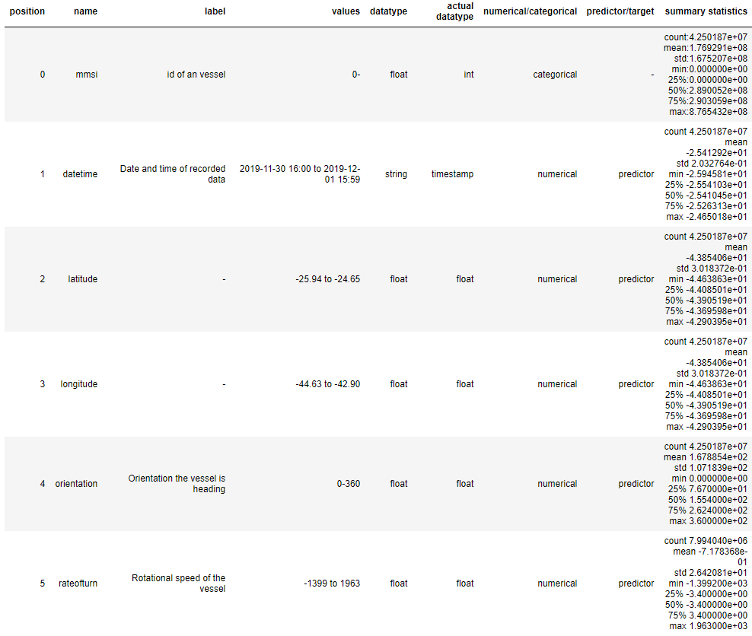
Codebook

Slide 5
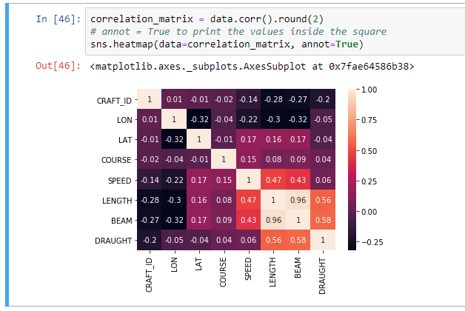
Correlation Matrix

Slide 6
Data visualization
Plotting individual ships
Seeing the routes

Slide 7
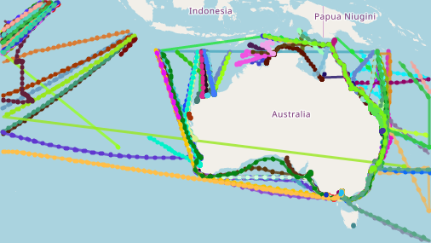

Slide 8
Clustering
finding a way to combine points together
which models?
K means
T-SNE
DB SCAN

Slide 9
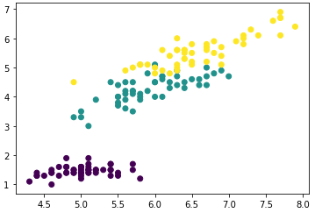
The data

Slide 10
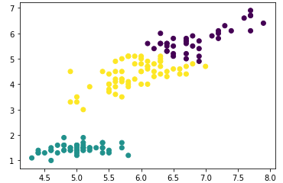
K-means

Slide 11
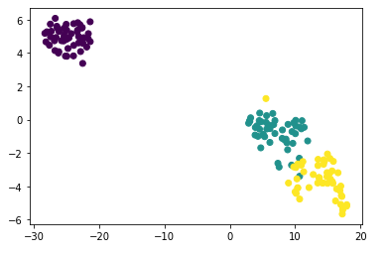
T-SNE

Slide 12
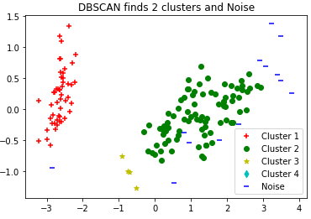
DBSCAN

Slide 13
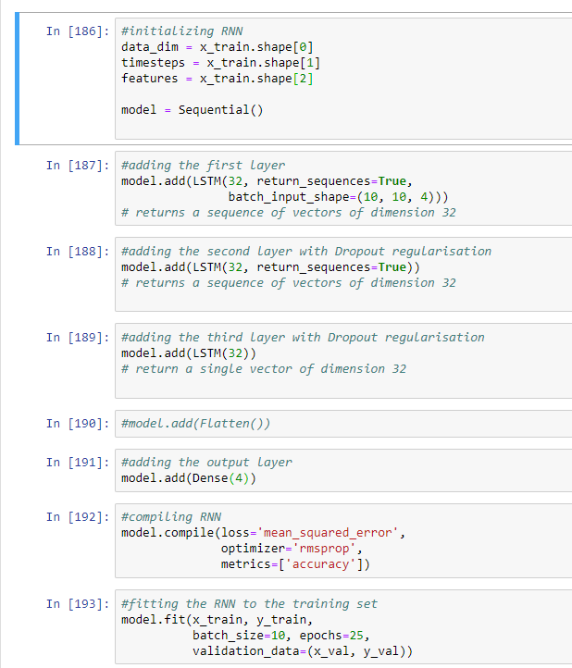
Recurrent Neural
Network v2
Computational limitations
Figuring it out on the way
Still getting it to run correctly
First results: Australian dataset

Slide 14
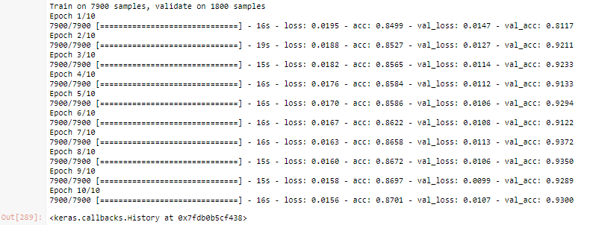

Slide 15
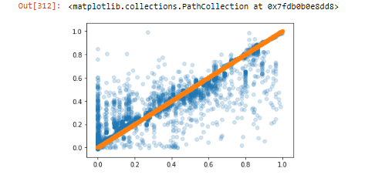

Slide 16
New strategy
1. Smaller area
2. manually look into the data
3. plot the data
a. find main route
b. find ships that adhere to the main route
c. label the ships accordingly
4. let the RNN learn what the main route(s) is/are
5. make it predict whether something is or isn't a anomaly based on that

Slide 17
Dynamic Markov Model
Works with probabilities
State changes
Approach based on statistics
Low computational cost
Works with large amounts of data

Slide 18
Feedback/Questions?
Thank you!

